Slide 1
Flu Vaccine Mandate NYC DOH
Presented By:
Jennifer Mendez, LPN
For Williamsburg Y Head Start

Slide 2
NYC DOH Mandate
2018- NYC mandated all children under the age of 5 attending childcare, Head Start, and Pre-Kindergarten to be vaccinated against Influenza (Flu).
2019- NYC no longer accepts religious or philosophical exemptions for any required vaccines including the influenza vaccine.
2019- Any program that does not enforce the mandate will be subject to a fine per child per day out of compliance, and be subject to closure.
2020- Any child enrolled in a childcare, Head Start, or Pre-Kindergarten program must be excluded from the program if not in compliance with the mandate, and will not be allowed to participate in-person or remote instruction.

Slide 3
Who is exempt from the vaccine?
Any child enrolled in a program who will turn 5 years old before December 31st, 2024.
Any child who has a medical exemption.
Any child whose family chooses to opt-out and will have their child remain home for the duration of the flu season. (April or May 2025)

Slide 4
Medical Exemptions
Form must be completed and signed by a physician licensed in New York State.
Medical exemptions are granted for no more than one year and requests must be resubmitted annually.
NYC Department of Health physicians review all medical exemption requests and may request additional information.

Slide 5
The following are not allowed as valid exemption reason as per NYCDOH.
•Egg allergy, even if anaphylactic
•Autism and/or developmental delay in the child or family member.
•Controlled seizures (with or without medication), or family history of seizures.
•Mild, acute illness (e.g. low-grade fever, cold, upper respiratory illness, diarrhea, ear infection).
•Prior flu infection.
•Contact with people who have weakened immune systems.
•Pregnancy in the household or contact with a pregnant woman.
•Family history of any vaccine reaction(s) or history of allergies (in a relative).
•Parental requests to delay or withhold vaccinations: these requests will not be considered.

Slide 6
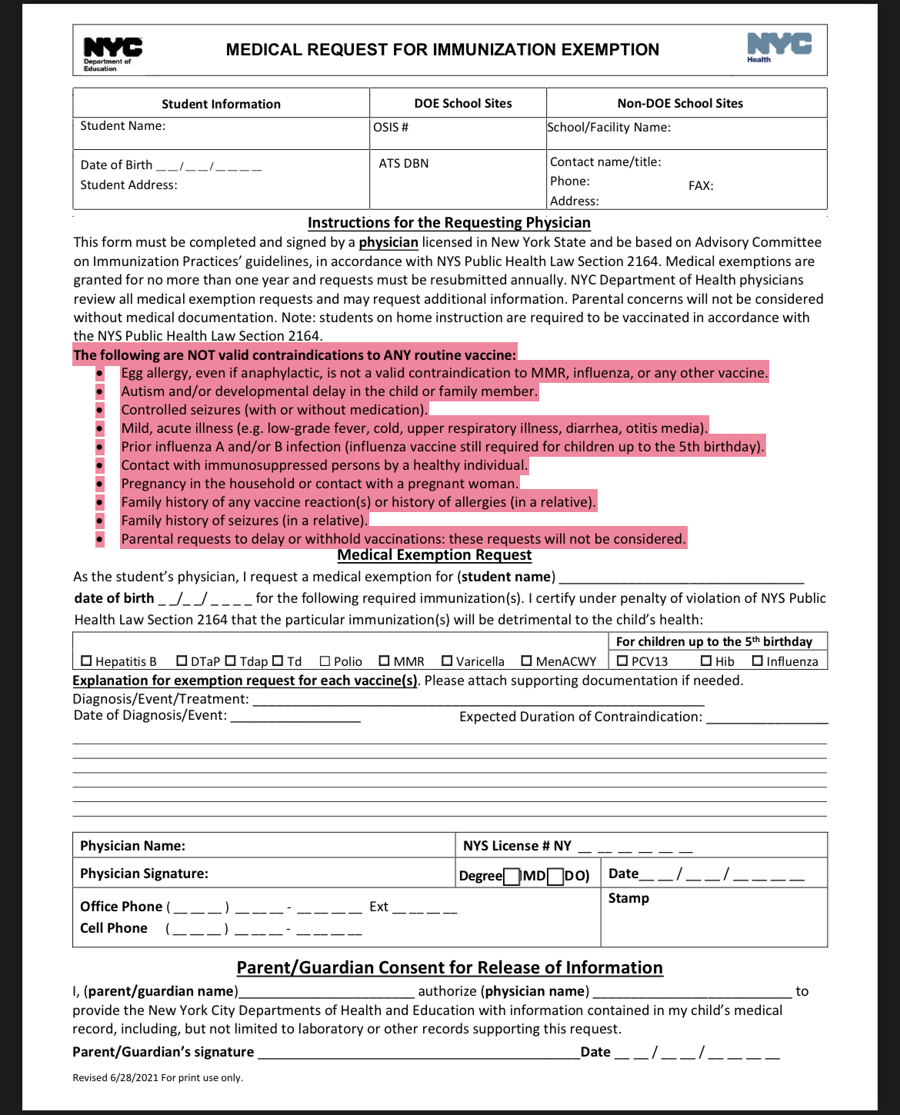

Slide 7
Why Get the Flu Vaccine?
Flu is a contagious disease that spreads around the United States every year, usually between October and May.
Anyone can get the flu, but it is more dangerous for some people. Infants and young children, people 65 years and older, pregnant people, and people with certain health conditions or a weakened immune system are at greatest risk of flu complications.
Pneumonia, bronchitis, sinus infections, and ear infections are examples of flu-related complications. If you have a medical condition, such as heart disease, cancer, or diabetes, flu can make it worse.
Flu can cause fever and chills, sore throat, muscle aches, fatigue, cough, headache, and runny or stuffy nose. Some people may have vomiting and diarrhea, though this is more common in children than adults.
In an average year, thousands of people in the United States die from flu, and many more are hospitalized. Flu vaccine prevents millions of illnesses and flu-related visits to the doctor each year.

Slide 8
Influenza Vaccine Info
CDC recommends everyone 6 months and older get vaccinated every flu season.
It takes about 2 weeks for protection to develop after vaccination.
There are many flu viruses, and they are always changing. Each year a new flu vaccine is made to protect against the influenza viruses believed to be likely to cause disease in the upcoming flu season. Even when the vaccine doesn’t exactly match these viruses, it may still provide some protection.
Influenza vaccine does not cause flu.
Influenza vaccine may be given at the same time as other vaccines.

Slide 9
Just a reminder
All flu vaccines must be administered by December 31st, 2024.
If you already received the vaccine after July 2024, there is no need for another vaccine.
If your child is not vaccinated by December 31st, 2024, they will not be allowed to attend school after winter school break.
Flu season is over when the NYC DOH declares the flu season over, usually by the end of April or beginning of May 2025.
Please submit proof of vaccination, as some facilities do not upload documentation to the Citywide Immunization Registry in a timely manner.

Slide 10
The Williamsburg Y Head Start thanks you for your on-going cooperation with us and the NYC DOH, and NYC DOE!

